Slide 1
Internal Audit Capability Statement
2014
Notes:
1

Slide 2
About the firm
1
Acquisory has been founded in 2010, by highly credentialed and experienced professionals, from PricewaterhouseCoopers, Arthur Andersen and Protiviti. The management team among themselves represent extensive experience in specialized services across M&A Advisory, and Operations & Risk Consulting.
We have an appreciation for dynamics of business, operations, transactions and necessary skills to blend practical business & commercial insights with tax & regulatory knowledge to identify effective solutions to all business problems. We partner with our clients through the entire business continuum from identification of the problem, to solution, to implementation.
We are hiring the best in class professionals with in depth experience in solving problems for our clients, from the big four, from premier consulting firms and from top universities.
Our Values
Solve client problems
Be responsive
Demonstrate the highest professional standards
Demonstrate deep industry knowledge
Motivate and retain high quality professionals
Promote and focus on innovation
Value Creation
People
Experience
Knowledge
Solution

Slide 3
About the firm
1
We currently have offices in Delhi and Mumbai, with a resource strength of 75+. The team is led by very experienced 7 partners / directors, who have had significant experience in Assurance, Transaction Advisory, Operations & Risk Consulting, Taxation and M&A Advisory with the Big 4 and in the Industry.
The team comprises of CA’s, CPA’s, MBA’s, CIA’s, CISA’s, Engineers and IT professionals. The firm has deep routed relationships with over 250 listed and private companies in both large and small & medium enterprise segments.
We have the ability to service your needs anywhere in the world.
New Delhi
Jaipur
Mumbai
Associate offices in Chennai, Bangalore, and Chandigarh
Our professionals have decades of experience working with clients in a broad array of industry sectors.
Our Industry Focus
Real Estate and Infra
Power and Energy
Media & Entertainment
These 7 industries are further divided into 40 sub-industry classifications to cater to every unique industry our clients come from
Consumer Products
Telecom
Services (Including IT & ITES)
Healthcare and life sciences

Slide 4
Our Services Offerings
1
Our professionals bring a structured approach to each and every assignment, with a unique set of objectives, requiring specific priorities, designed to deliver the best results. With a widespread and detailed understanding of operations, our professionals are able to rapidly formulate and execute practical solutions in complex business problems/environments by:
Obtaining in-depth understanding of the business;
Collating all facts and getting them right;
Planning and partnering
Analyzing and diagnosing the problem
Identifying practical solutions
Supporting and leading
Establishing a self-sustaining organization
M&A Advisory
Operations & Risk Consulting
Transaction Advisory
M&A – Lead Advisory
Corporate Restructuring
Due Diligence
Valuation
Deal Structuring / Negotiation
Asset Management
M&A Integration
Internal Audit
Cost Reduction
Working Capital Optimization
Process Reengineering
Forensics / Investigation Support
Accounting / Financial Reporting Support
Financial appraisal and modelling
Financial Closure
Biding strategy
RFQ Evaluation
RFP Evaluation
Preparation of Concession Agreement
Feasibility Study
Detail Project Report
Due Diligence

Slide 5
Our Operational and Risk Consulting Services
1
Remaining productive, staying competitive, and enjoying continuous improvement means making the best, most informed operational decisions in a timely manner. Business success centers on the ability of a company to correctly recognize and successfully manage the risks associated within its operations. Breakthrough performance requires a unique combination of innovative thinking and disciplined follow-through. Strategy stands or falls on execution.
Our professionals work together with senior executives to significantly help improve the performance of their businesses and to choose the right course of actions, merging executable strategy, operations and technology.
We are able to assist you in meeting your business goals by providing customized solutions integrating our expertise in:
Operations & Risk Consulting
Internal Audit
Cost Reduction
Working Capital Optimization
Process Reengineering
Forensics / Investigation Support
Accounting / Reporting Support

Slide 6
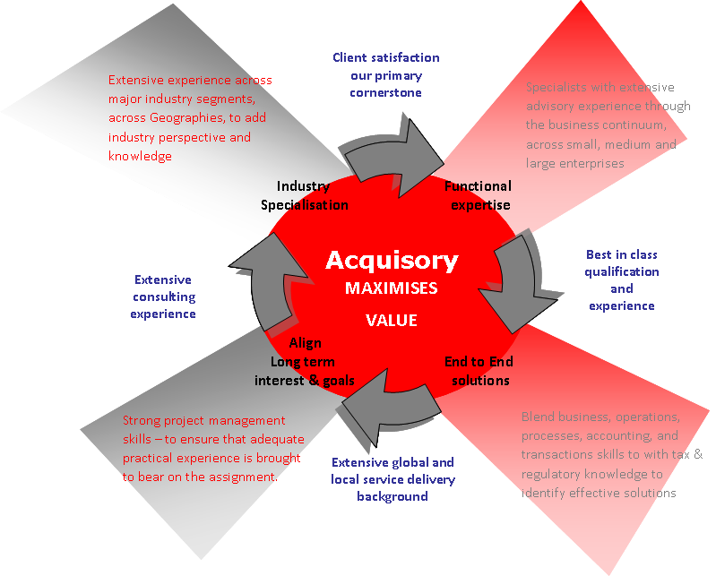
Why Acquisory
1

Slide 7
Understanding of Industry and business
2
We apply the industry model in each and every assignment of internal audit and operation and risk consulting engagement to get a intelligent insights of the business
Business Planning
Corporate Governance
Target Markets & Environment Intelligence
Pricing
Strategic Business Alliances
Projects & Expansion
Revenue and Services
Contract / Agreements
Documentation
Marketing and Selling
Client Service Delivery Monitoring of SLA / penalties
Collections
Invoicing
Expenses
Administration and facilities
Information Technology infrastructure expenses
Recruitment and Staff expenses
Payroll
Administrative
Fixed Assets Management
Financial accounting
Budgeting & MIS
Monthly Closures
Strategic Management
Core Business
Resource Management

Slide 8
Our Overall Approach
2
Our Internal Audit services are based on a field tested methodology which is consistent with the International Standards for the Professional Practice of Internal Auditing. We will adapt our IA methodology and leverage our proprietary knowledge database for the internal audit
Internal Audit Methodology
Evaluate Power of Customer / Supplier
Understand
Owners, Key Products
Environment
Analyze
Competition and Key Risks
Understand Regulatory Environment
Understand Business Goals and Objectives
Utilize
Knowledge of
Industry
Analysis of Business Strategy
Internal
Quality
Assessment
External
Quality
Assessment
Analysis of
Business
Processes
Execute Risk Assessment
Analysis of
Risk
Evidence
Create and Update Internal Audit Plan
Test Operating Effectiveness
Carry out Audit Procedures
Evidence
Validate Findings and Conclude
Evidence
Final Report and Presentation
Internal Audit
Performance
Management

Slide 9
3
Our Customized Approach
Understand
& Scope
Plan &
Analyze
Execution
Reporting
Acquisory provides independent, objective assurance and consulting activity designed to add value and improve an organization's operations. It helps an organization accomplish its objectives by bringing a systematic, disciplined approach to evaluate and improve the effectiveness of risk management, control, and governance processes by :
Understanding business context | Understand the business objectives for the process using COSO framework and understand how these link to the organization’s overall objectives. Understand the organization structure , business processes, policies and processes, management reports, systems and data used, regulatory framework and overall environment Conduct interviews with various senior stakeholders.
Understanding current state As Is | Understand operations of the Company. Obtain an understanding of the existing process Conduct interviews with the process owners to understand As-is processes Identify key concern areas based on discussion with the process owners and management Document the process and validate understanding Prepare audit work programs for all the areas

Slide 10
3
Our Customized Approach
Understand
& Scope
Plan &
Analyze
Execution
Reporting
Formulate approach and project plan | Create detailed internal project plan Identify preliminary information required Clearly identify areas to be covered by Acquisory and obtain by-in of the management Post identification and prioritizing of areas to be covered develop a audit plan
Analyze process, risk and evaluate controls | Review the processes, identify and source risks associated with the process Prioritize the risks based on likelihood of occurrence & significance of impact Evaluate at inherent and residual risk levels Evaluate design for efficiency and effectiveness Evaluate design for control
Analyze gaps | Review the process and the risk and benchmark with the leading practices/regulatory standards Identify gaps Prioritize these gaps / weakness with respect to business, relevance and quantify potential business impact of the same

Slide 11
3
Our Customized Approach
Understand
& Scope
Plan &
Analyze
Execution
Reporting
Formulate Recommendations | Prepare remediation action plan for identified weakness Finalize form and content of presenting recommendations Prepare draft recommendations Evaluate implications of/on business infrastructure and landscape Support recommendations with findings and conclusions
Design solution | Define remediation plan for gaps Evaluate and select solution option Finalize the solution design with the client Articulate implementation roadmap
Formulate Conclusions | Articulate exceptions and deficiencies Quantify impacts Prioritize exceptions and deficiencies

Slide 12
3
Our Customized Approach
Understand
& Scope
Plan &
Analyze
Execution
Reporting
Finalize deliverables | Prepare deliverables Review and finalize report / deliverables with client / stake holders Present report to Senior Management, discuss findings and obtain management acceptance and proposed action plan for all Make presentations to the audit committee
We are committed to exceeding Company’s expectations for their internal audit department. To do that, we want to ensure we understand your expectations.
We believe that Acquisory can assist its clients in meeting their needs using our proven methodologies and frameworks as well our experienced personnel who are familiar with similar assignments. Our Value Proposition, Methodologies and customized Approach for the Company have been described in detail in the subsequent slides

Slide 13
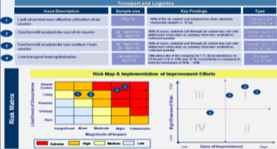
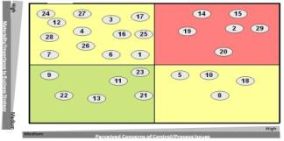
Sample Deliverables
4
Executive Summary
Internal Audit report:
A high-level overview of the engagement, including scope and key exceptions noted
Detailed discussion of key issues identified during the audit, including value-added recommendations
Summarised risk matrix to provide list of issues in a snapshot
Detailed
Issues
Risk Matrix

Slide 14
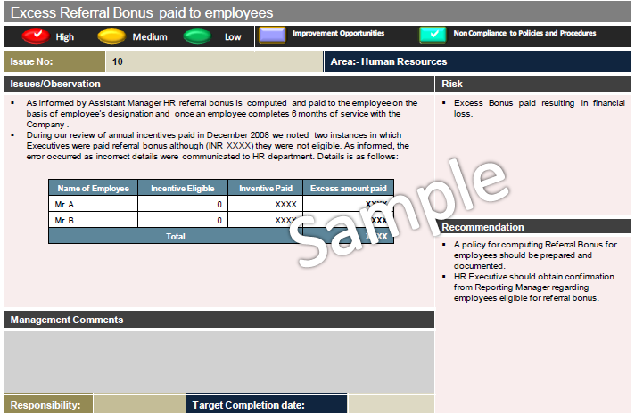
4
Sample deliverables
We work with you to create a customized reporting solution. Typically our comprehensive reports are designed to allow users to understand relevant information on issues raised and the related opportunities for control/process enhancement. Succinct executive summaries and action matrices highlighting important issues are a key part of our reporting style.

Slide 15
5
Select Team and Firm Credentials
Our experience spans across business, operations, processes, accounting, and transactions; providing services to private equity firms, hedge funds and strategic corporate acquirers, partnering with them through the entire deal continuum.
Amtek
Actis
Avra
AIG
Avendus
Avaya
Bharti Realty
British Gas
Bhilwara Energy
Bharat Starch
BW Highway
Baer Capital
Citibank
Cadim
Caltex
Castrol
Crompton Greaves
Clearwater Capital
DB Realty
DCM Shriram
Dorling Kindersley
Deutsche Bank
Phoenix Mills
Damag Properties
DE Shaw
Emmar MGF
Jodhana developers
Edelweiss Capital
Federal Mogul
Flexituff
Fortune Brands
General Electric
Guardian
Grasim
Hewlett Packard
Hitachi
Logix Infrastruture
HCL Group
Helion
ILFS
India Prepaid (Oxigen)
ICICI Ventures
Jagatjit Industries
Jindal Drilling
FE Clean
EWDPL
Sunapollo
UppalIT projects
Indian Hotels Company
Phoenix Infra
Jubilant Organosys
Kotak
Rustomjee
Larsen & Toubro
Maruti Udyog
Maersk
Monnet Ispat
Max Bupa
Manjeera
New York Life
Nadathur Investments
NIIT
Norwest Venture Partners
Nuance
OCS
Oxford properties
Pernod Ricard
Pacific Alliance
Rabo Bank
Reliance Capital
Standard Chartered
Mighty group
Wels pun Energy
Sun Group
Sanawar School
Sachsen Fonds
Star TV
Sony
Scandent
Skillsoft
Shell
SITQ
SRF
S N Power
Solvay
Sumitomo
Swedish Match
TATA Teleservices
Trinity Capital
TV 18
Temasek
Tupperware
Vedior
Wachovia
Wipro
ZEE Group
HDFC Fund
IndiaReit
Ansal API
L&T
15

Slide 16
5
Select Firm and Team Clients

Slide 17
Illustrative team structure
5
We propose to use an experienced team of resources in order to bring together Industry expertise, consulting expertise, and GAAP expertise
The team will endeavour to remain in constant touch with the client to provide them regular updates
Client
Project Director:
Managing Director, Acquisory
Project Manager
Principal, Acquisory
Client Execution team
Project Execution
Acquisory experienced resources
17

Slide 18
5
Our Team
Sumchit is a Managing Director, leading the M&A Advisory practice for Acquisory, India. Sumchit is a Chartered Accountant by qualification with over fifteen years of experience with PricewaterhouseCoopers, Ernst & Young and Protiviti.
His risk consulting experience spans through Internal Audit, Asset Management, Sox Compliance, Process Reviews, Setting Up and Management of Finance Functions.
In his last assignment he set up and led the M&A risk advisory practice for Protiviti in India. His transactions experience includes advising and assisting large Private Equity funds and Strategic investors in their investment activities by providing comfort on their proposed investments and helping achieve their commercial and strategic objectives.
Sumchit Anand
sumchit.anand@acquisory.com
Mobile: +91 98100 48578
Divya is a Director in the Operations Consulting practice of Acquisory. A Chartered Accountant by qualification, Divya has over 15 years of experience including over 11 years with PricewaterhouseCoopers in India.
She has also worked in the UK practice of PwC on a secondment and managed some large relationships in the UK. Divya has worked on a range of assignments, and has expertise in Operations Consulting, Process Assurance & Evaluation, Internal Audits and Accounting & Reporting.
Divya set up and managed an outsourced operations team for one of the largest IT companies in the world for around 4 years, focusing on their marketing activities like schemes, reseller programs, wholesaler programs. Divya has worked across Industries including Information Technology, Manufacturing, FMCG, Hospitality, and Education.
Divya Vij
Divya.vij@acquisory.com
Mobile: +91 98100 23376

Slide 19
5
Illustrative team structure
Jeenendra Bhandari is a Director with over 15 years of expireances. He is a Fellow member of the Institute of Chartered Accountants of India and a Certified Public Accountant.
He also became a Certified Public Accountant from Delaware, United States in 1999. Prior to joining the firm as a partner, Jeenendra was with the Tax, Regulatory and Business Advisory practice of Arthur Andersen at Mumbai.
He enjoys an excellent reputation and has a strong network in the corporate sector. He also shares the responsibility for the ongoing development of the firm’s practice. Jeenendra also sits on the Board of technology and healthcare companies
Krishan is a Director with Acquisory in our Delhi Office and has over 10 years of working experience with Protiviti and A.F.Ferguson & Co. (a member firm of Deloitte). He has worked extensively across industry sectors such as Telecom, Power, Real Estate, Infrastructure, Manufacturing, Media and IT.
A Chartered Accountant by qualification, his experience includes asset management, process reviews, Internal Audit forensics and transaction support. His experience spans across China, Middle East and Africa
Nehal Shah is a qualified Chartered Accountant, Certified Public Accountant and Certified Information Systems Auditor, having over 12 years of professional experience. She has worked with PricewaterhouseCoopers (Mumbai and Virginia); Protiviti Consulting Pvt. Ltd., Mumbai and Discern Risk, Mumbai.
Nehal’s focus is internal audit, business process review, risk management (including fraud risk management), Information Technology General Controls and Sarbanes Oxley.
Nehal has worked across industry segments including Manufacturing, IT & ITES, BPO, Services and Pharma.
Jeenendra Bhandari
jbhandari@mgbco.com
Mobile: +91 98672-99672
Krishan Goyal
krishan.goyal@acquisory.com
Mobile: +91 97170 33599
Nehal Shah
nehalshah@mgbadvisors.com
Mobile: +91-98332-95387

Slide 20
Solutions For Growth
Acquire ----Sustainable Growth
Acquire ---- Improved Performance
Acquire ---- Better Processes
Acquire ---- Greater Control
www.Acquisory.com

